Slide 1
<Icyice>
Team #9
Eunbi Kim , Applied Data Science
Keisha Rorimpandey, Civil Engineering
Shan Jiang, Applied Data Science
Jiazheng Zhang, Applied Data Science

Slide 2
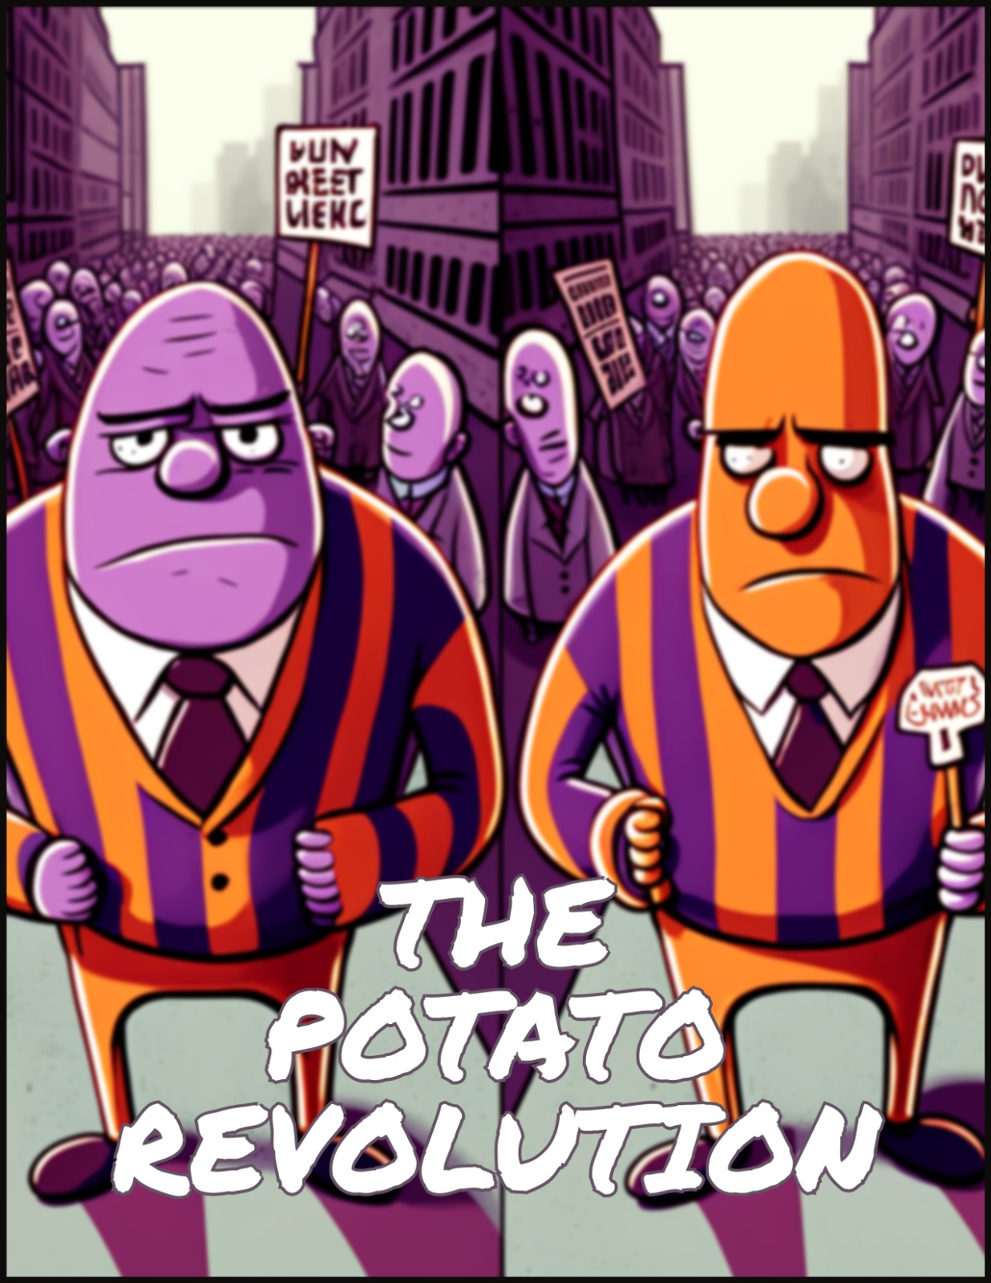
Our Story …
In year 3000, the justice system called COMPAS in potato planet is a biased system in favor of the purple potatoes instead of the orange potatoes.
To reduce the injustice of this AI system, a new dataset are collected by offering each potato an opportunity to go under probation instead of to be imprisoned in order to achieve equality.
The retrained COMPAS system finally brings them a better justice future.
Up to ¼ of a comic page

Slide 3
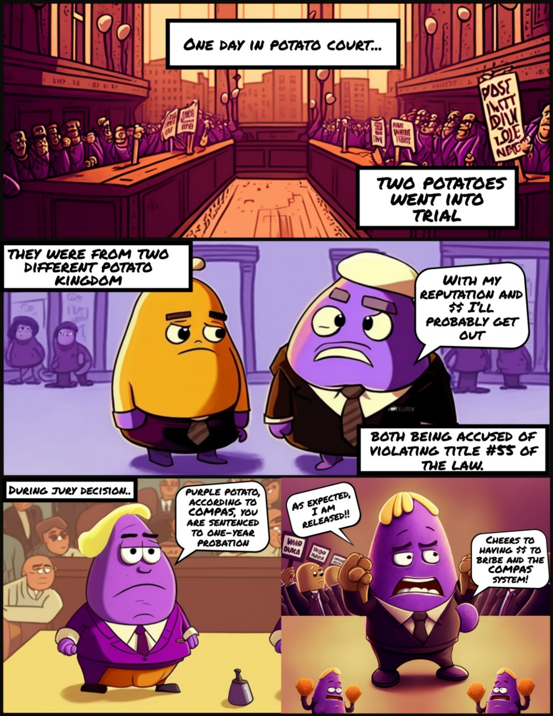
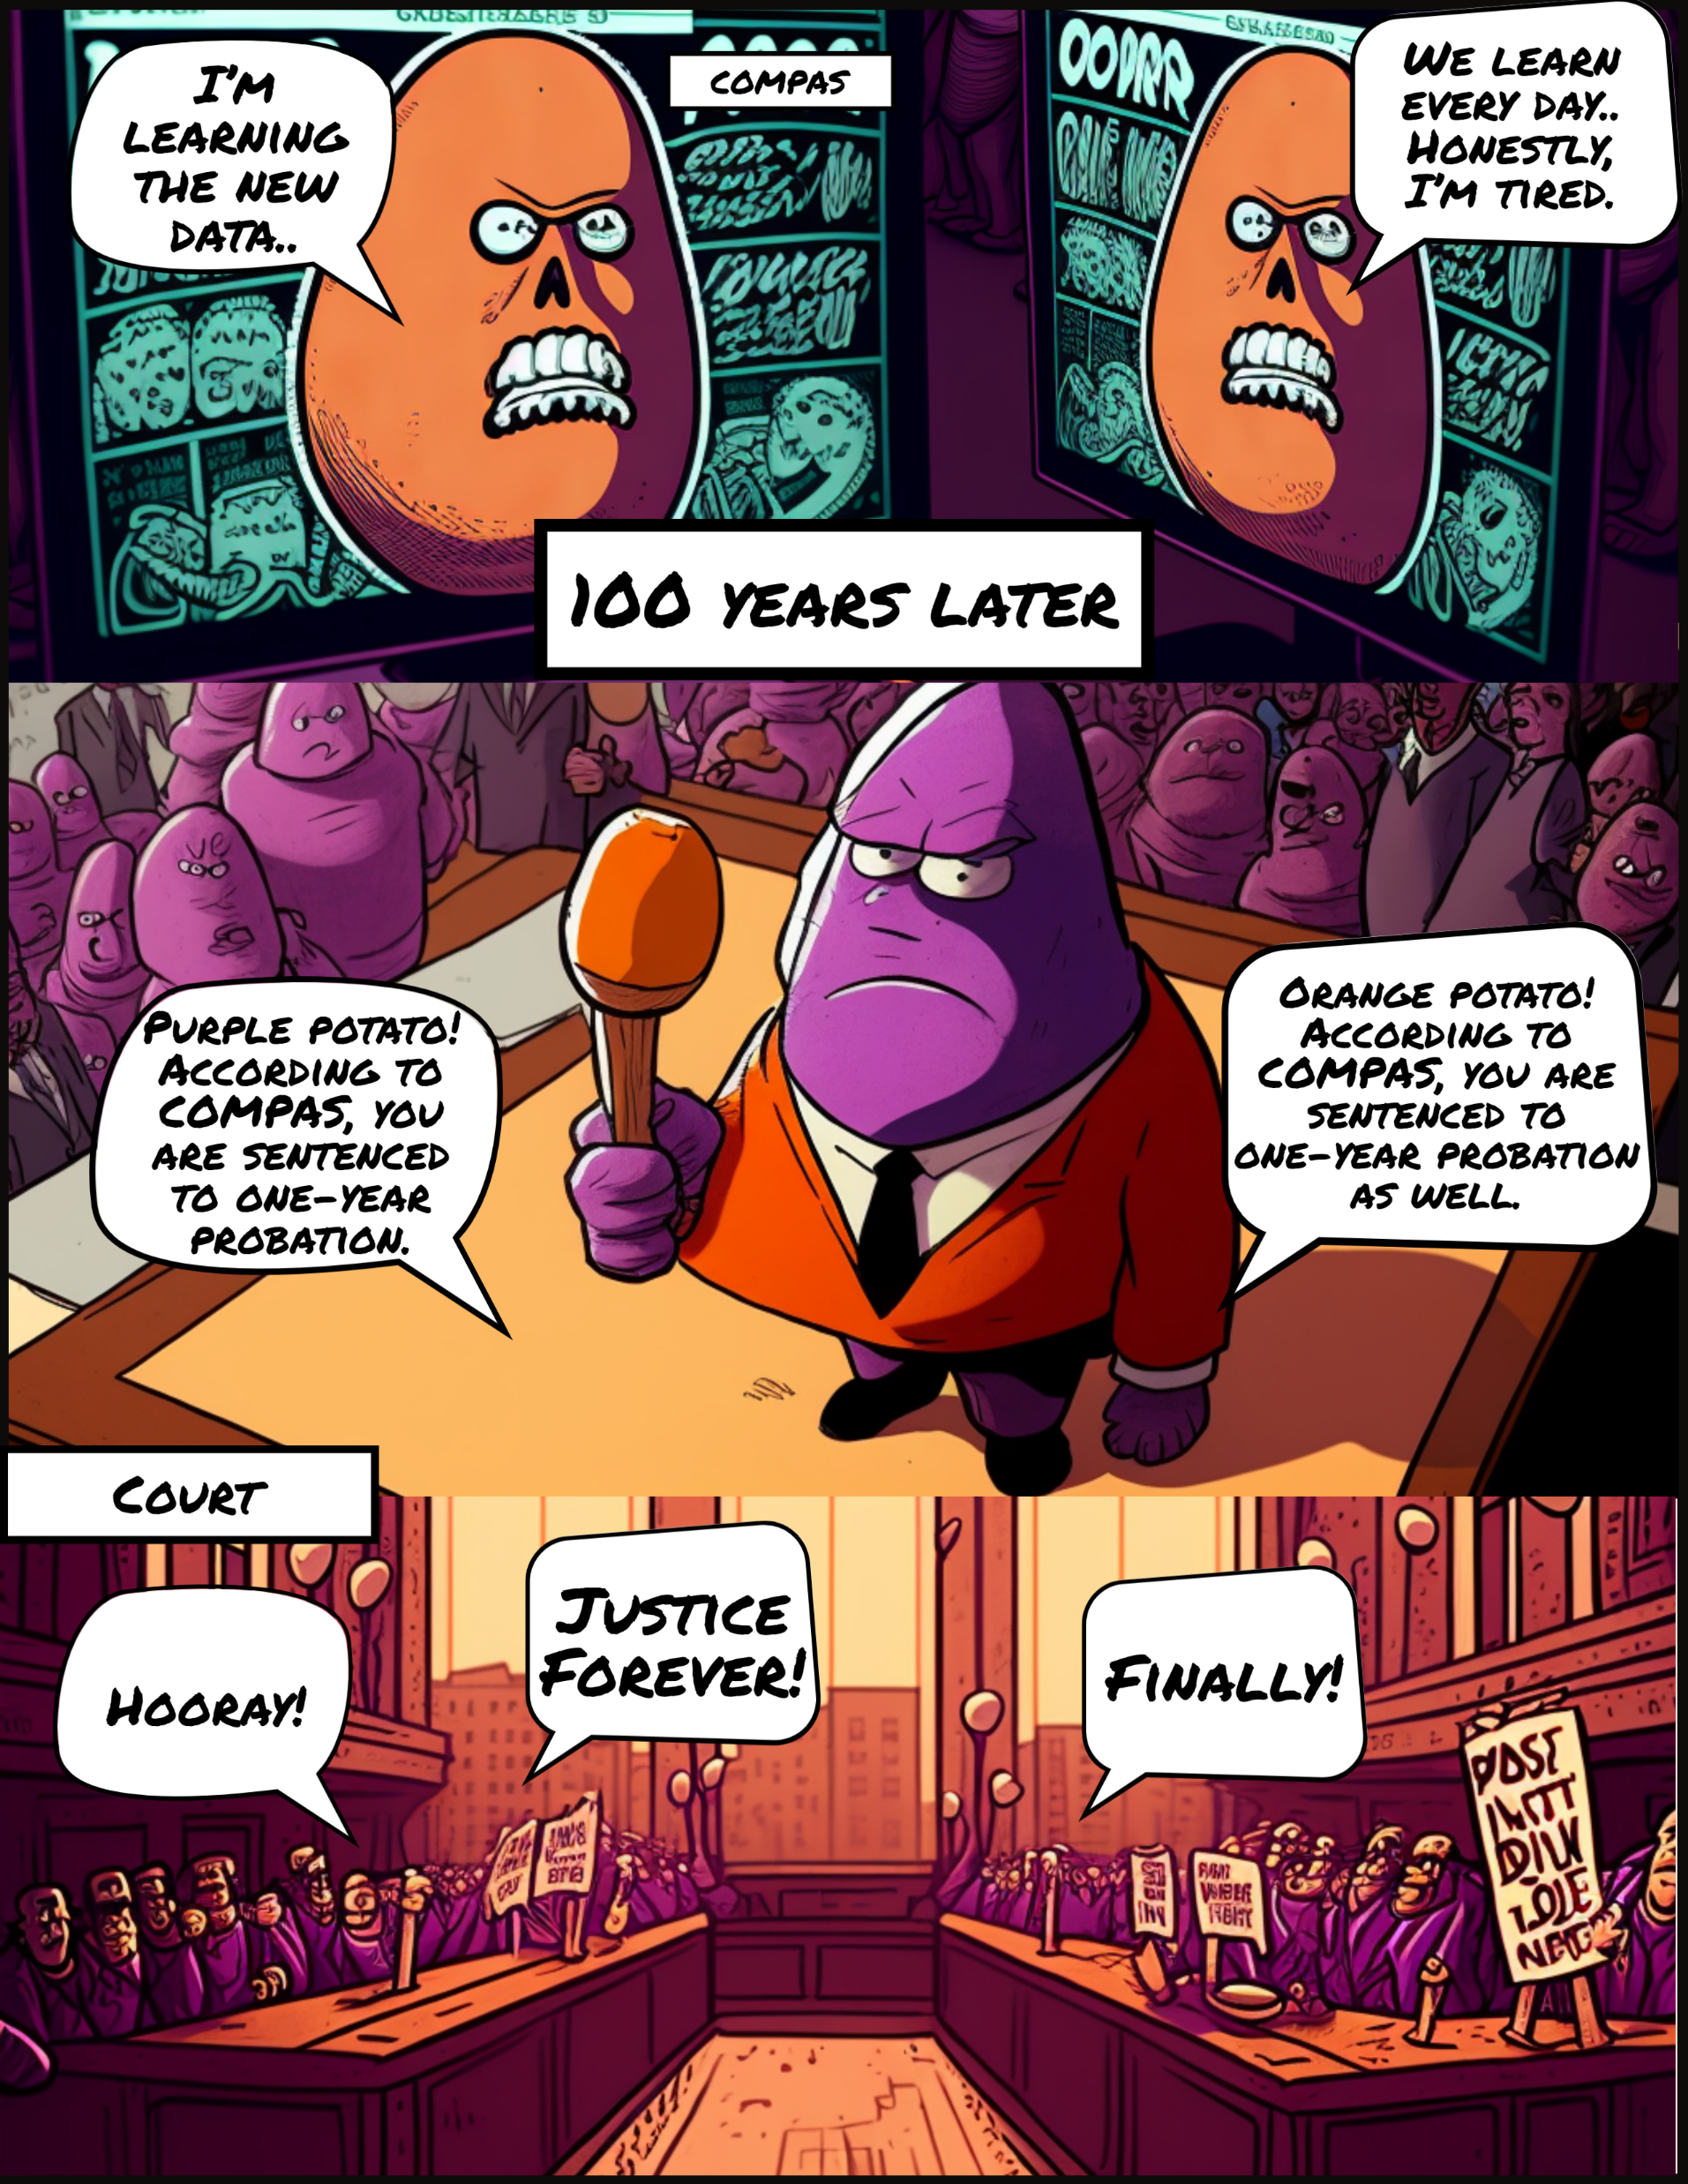
Our Imagery …

Slide 4
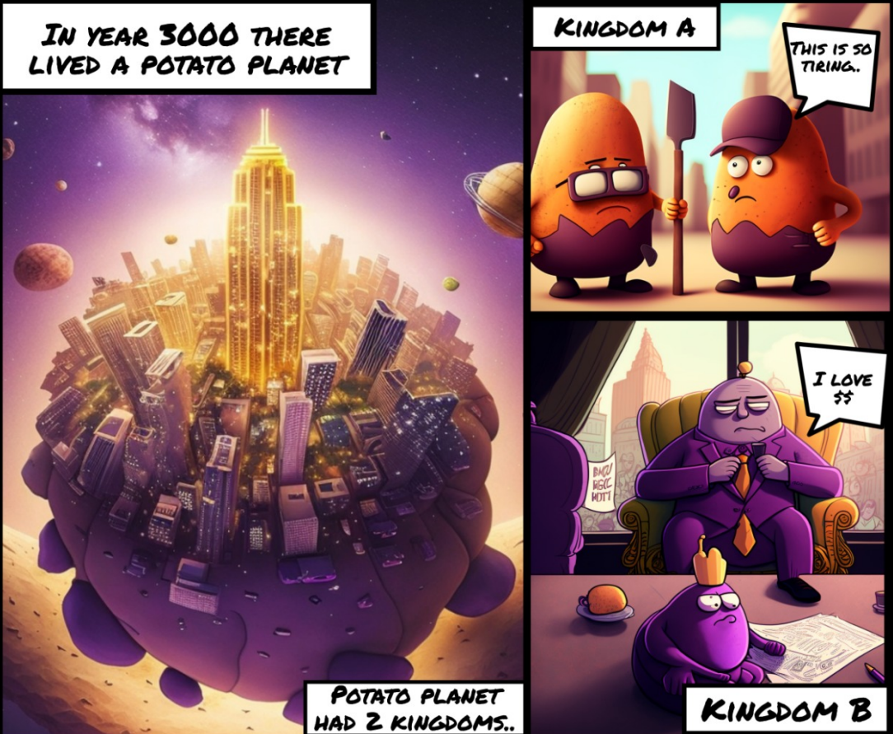
Our Technical Approach
For Midjourney:
Produce image with keywords
Blend two images
Character consistency
For Adobe:
Cropping tool
Use comic strip template
Use speech bubble template to express words

Slide 5
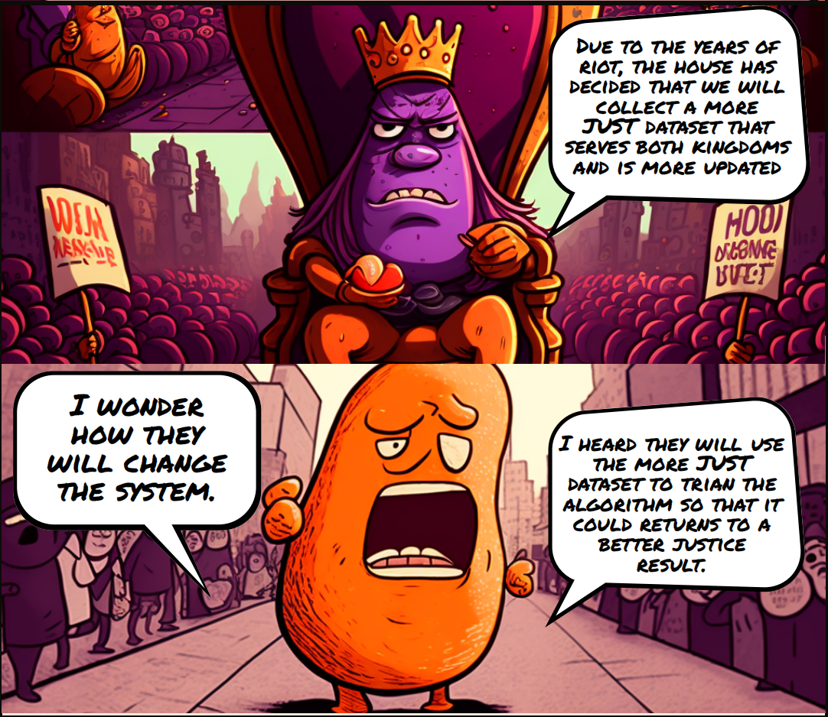
Our Theme Engagement
This story engages with the topic of future justice by presenting a scenario where a society is able to recognize and address an unjust AI system, and then implement a solution that creates more equity and fairness for all individuals, regardless of their background or status.
The story highlights the importance of collecting data and evaluating the effectiveness of AI algorithms in achieving justice, which brings a better future for all.

Slide 6

Our Big Challenge(s)
For theme selection, the problem we addressed in our story hasn’t been solved in our reality yet. For this, the feasibility of solution would be a big challenge.
For technical, It is hard to keep the consistency of our image when the keywords are used in different scenarios even though using the same keywords.

